Slide 1


Yassine Boujelben
12/30/2023

Slide 2

Outline
Executive Summary
Introduction
Methodology
Results
Conclusion
Appendix

Slide 3
Executive Summary
This project follows these steps:
Data Collection
Data Wrangling
Exploratory Data Analysis
Interactive Visual Analytics
Predictive Analysis (Classification)

Slide 4
Executive Summary
This project produced the following outputs and visualizations:
Exploratory Data Analysis (EDA) results
Geospatial analytics
Interactive dashboard
Predictive analysis of classification models

Slide 5
Introduction
SpaceX conducts Falcon 9 rocket launches at an approximate expense of $62 million, a notably lower cost compared to other providers whose charges typically exceed $165 million. A significant factor contributing to this cost efficiency is SpaceX's ability to successfully land and reuse the initial stage of the rocket.
By developing predictions regarding the first stage's landing outcome, we can ascertain the overall launch cost. This information can then be utilized to evaluate whether an alternative company should submit a bid to compete with SpaceX for a rocket launch.
Ultimately, this project aims to forecast the successful landing of the SpaceX Falcon 9 first stage.

Slide 6

Section 1

Slide 7
Methodology
Executive Summary
Data collection methodology:
Describe how data was collected
Perform data wrangling
Describe how data was processed
Perform exploratory data analysis (EDA) using visualization and SQL
Perform interactive visual analytics using Folium and Plotly Dash
Perform predictive analysis using classification models
How to build, tune, evaluate classification models

Slide 8
Data Collection
The process of gathering data involved a dual approach, combining API requests from SpaceX's public API and extracting information through web scraping from a table found in SpaceX's Wikipedia entry. The subsequent slide will illustrate the flowchart detailing the data collection process from the API, while the following one will present the flowchart outlining the data collection through web scraping.
Columns retrieved from SpaceX API data encompass Flight Number, Date, Booster Version, Payload Mass, Orbit, Launch Site, Outcome, Flights, Grid Fins, Reused, Legs, Landing, Block, Reused Count, Serial, Longitude, and Latitude. In contrast, Wikipedia web scraping yielded data columns such as Flight No., Launch site, Payload, Payload Mass, Orbit, Customer, Launch outcome, Version Booster, Booster landing, Date, and Time.

Slide 9
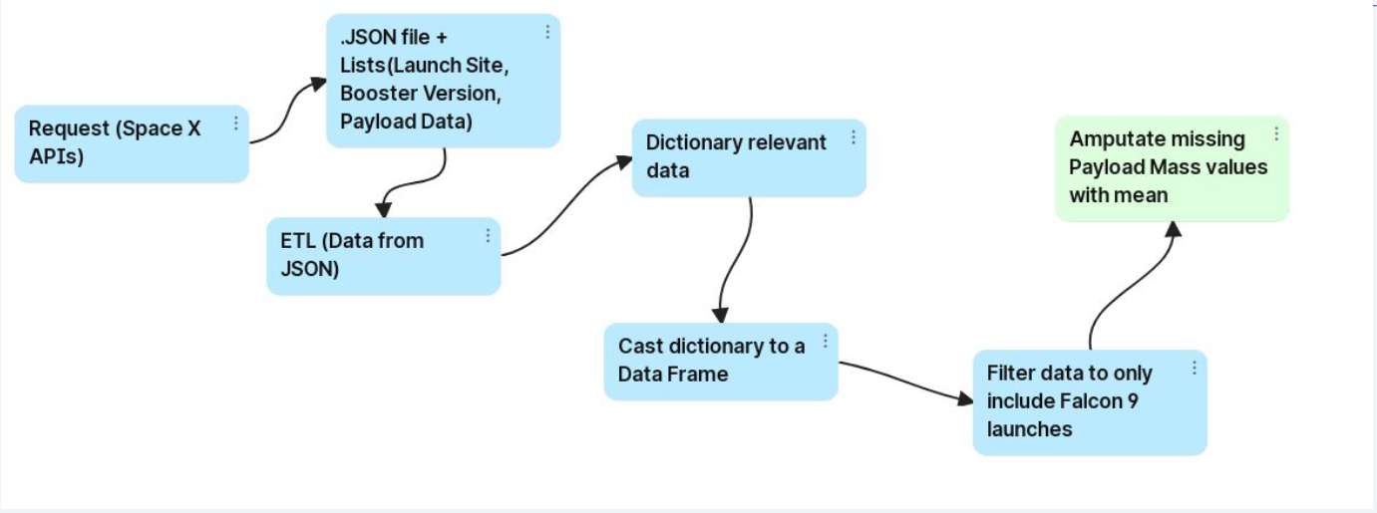
Data Collection – SpaceX API
https://github.com/boujyass/DS_IBM_Final_Project/blob/main/jupyter-labs-spacex-data-collection-api.ipynb- Data Collection Notebook repository link.

Slide 10
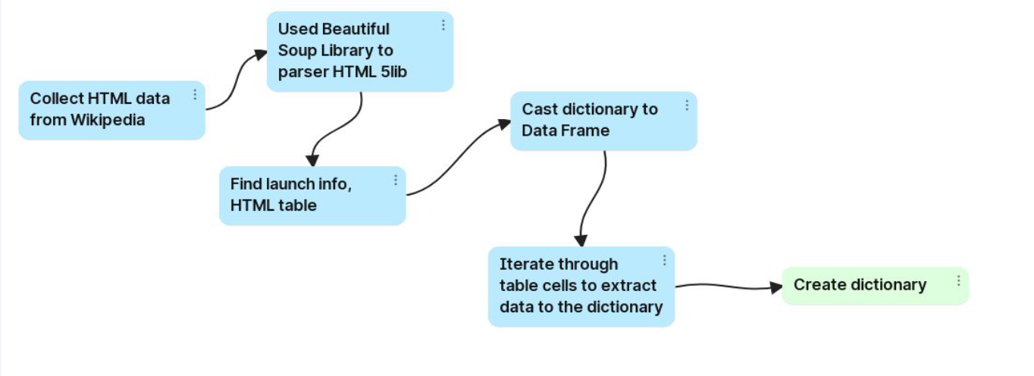
Data Collection - Scraping
https://github.com/boujyass/DS_IBM_Final_Project/blob/main/jupyter-labs-webscraping.ipynb- Web scraping Notebook repository link.

Slide 11
Data Wrangling
Generate a training label for landing outcomes, categorizing success as 1 and failure as 0.
The 'Outcome' column comprises two elements: 'Mission Outcome' and 'Landing Location.'
Introduce a new training label column named 'class,' assigning a value of 1 if 'Mission Outcome' is true and 0 otherwise. Utilize the following value mapping:
True ASDS, True RTLS, & True Ocean → set to 1
None, None, False ASDS, None ASDS, False Ocean, False RTLS → set to 0.
Github repository link:
https://github.com/boujyass/DS_IBM_Final_Project/blob/main/labs-jupyter-spacex-Data%20wrangling.ipynb

Slide 12
EDA with Data Visualization
Conducted Exploratory Data Analysis (EDA) on key variables including Flight Number, Payload Mass, Launch Site, Orbit, Class, and Year. Explored relationships such as Flight Number vs. Payload Mass, Flight Number vs. Launch Site, Payload Mass vs. Launch Site, Orbit vs. Success Rate, Flight Number vs. Orbit, Payload vs. Orbit, and examined the yearly trend in Success. Utilized scatter plots, line charts, and bar plots to discern patterns and evaluate potential relationships among variables, aiming to identify significant insights for potential integration into the machine learning model training process.
Github: https://github.com/boujyass/DS_IBM_Final_Project/blob/main/jupyter-labs-eda-dataviz.ipynb.jupyterlite.ipynb

Slide 13
EDA with SQL
Loaded dataset into IBM DB2 Database for seamless storage and retrieval.
Employed SQL Python integration to execute queries and gain insights.
Executed queries to extract information on launch site names, mission outcomes, payload sizes of customers, booster versions, and landing outcomes.
Leveraged the power of SQL for a thorough exploration of the dataset, aiding in better comprehension and subsequent analysis.
Github: https://github.com/boujyass/DS_IBM_Final_Project/blob/main/jupyter-labs-eda-sql-coursera_sqllite.ipynb

Slide 14
Build an Interactive Map with Folium
Implemented Folium maps to visually mark Launch Sites.
Distinguished between successful and unsuccessful landings on the maps.
Provided proximity examples to key locations, including Railway, Highway, Coast, and City.
Facilitated a better understanding of the rationale behind the selection of launch sites through visual representation.
Visualized successful landings relative to location, offering insights into geographical context.
Github: https://github.com/boujyass/DS_IBM_Final_Project/blob/main/lab_jupyter_launch_site_location.jupyterlite.ipynb

Slide 15
Build a Dashboard with Plotly Dash
Dashboard components consist of a pie chart and a scatter plot.
The pie chart provides options to display the distribution of successful landings across all launch sites or individual launch site success rates.
The scatter plot allows users to select between visualizing data for all sites or an individual site, with payload mass adjustable via a slider ranging from 0 to 10000 kg.
The pie chart serves the purpose of visualizing launch site success rates.
The scatter plot facilitates insights into variations in success across launch sites, payload masses, and booster version categories.
Github: https://github.com/boujyass/DS_IBM_Final_Project/blob/main/spacex_dash_app.py

Slide 16
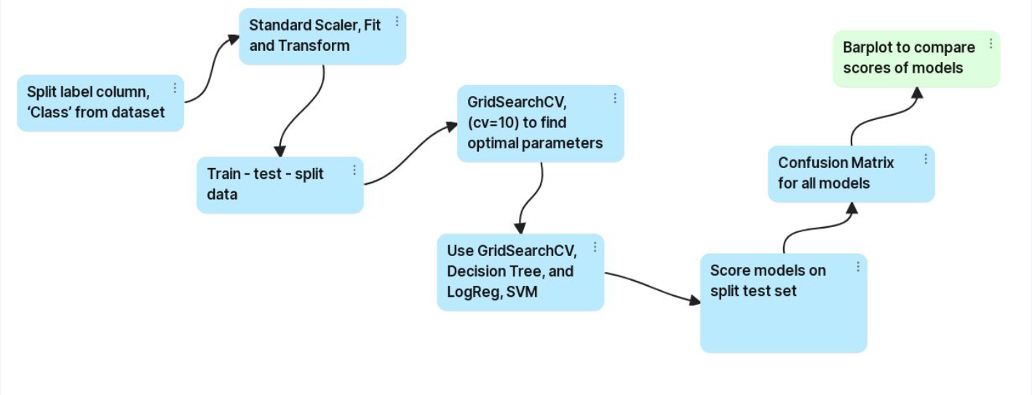
Predictive Analysis (Classification)
Github Repository link:
https://github.com/boujyass/DS_IBM_Final_Project/blob/main/SpaceX_Machine_Learning_Prediction_Part_5.jupyterlite.ipynb

Slide 17
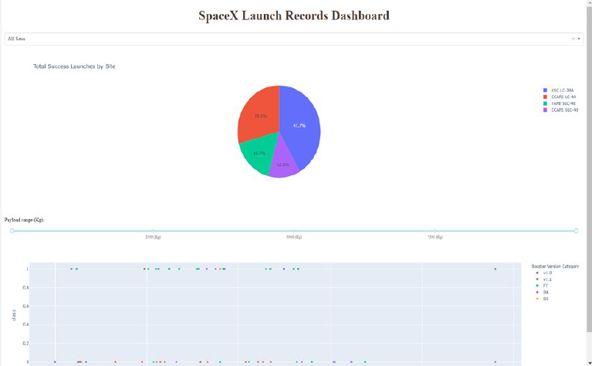
Results
Preview of the Plotly dashboard showcasing various components.
Upcoming sections will present the outcomes of Exploratory Data Analysis (EDA) with visualizations, EDA with SQL, an Interactive Map using Folium, and ultimately, the model results achieving an accuracy of approximately 83%.

Slide 18

Section 2

Slide 19
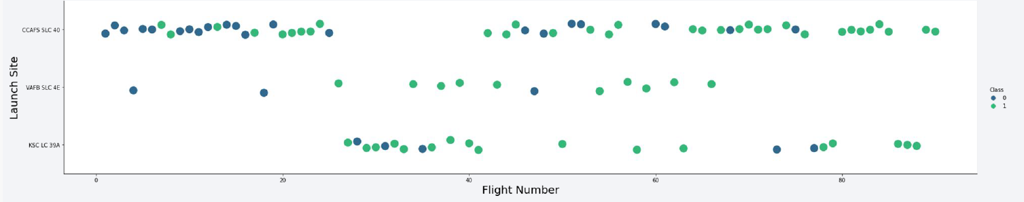
Flight Number vs. Launch Site
Green signifies a successful launch, while purple denotes an unsuccessful one.
The graphical representation implies a noticeable uptrend in the success rate over time, as highlighted by the ascending Flight Number. Notably, there appears to be a significant breakthrough around flight 20, contributing to a substantial increase in the success rate.
Cape Canaveral Air Force Station (CCAFS) emerges as the primary launch site, evident from its notably higher launch volume compared to other sites.

Slide 20
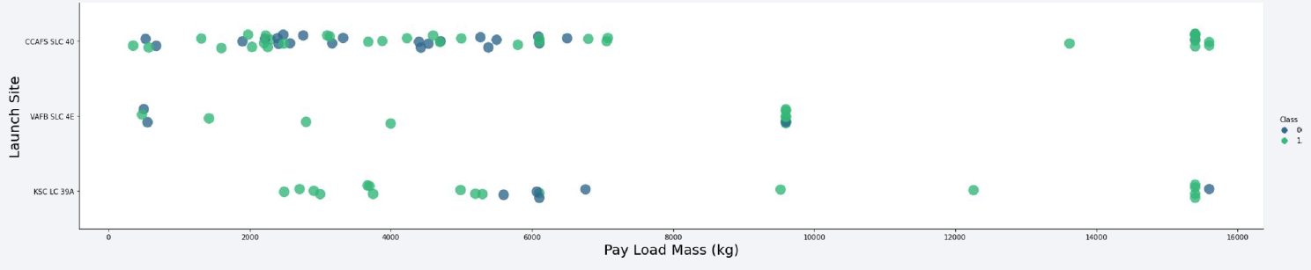
Payload vs. Launch Site
Green indicates a successful launch, while purple signifies an unsuccessful one.
Observation reveals that payload mass predominantly falls within the range of 0-6000 kg.
Notably, different launch sites appear to employ varying payload mass ranges, suggesting a site-specific consideration in payload capacity.

Slide 21
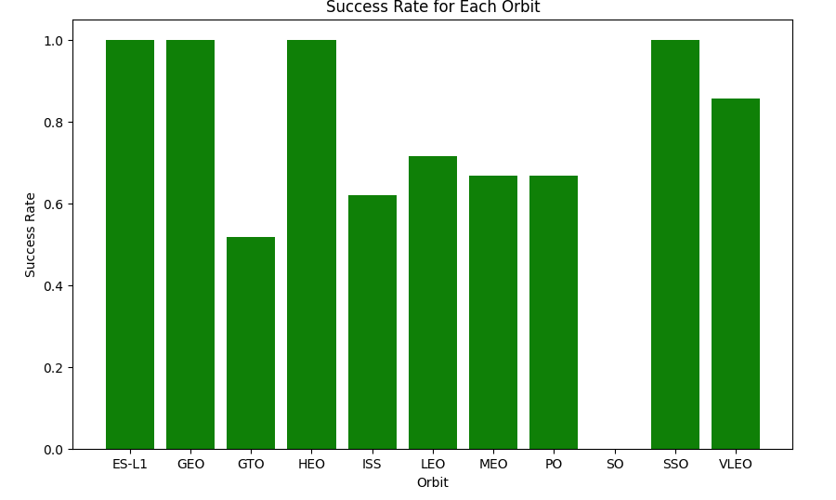
Success Rate vs. Orbit Type
The bar chart depicting Success Rate vs. Orbit Type highlights orbits with the highest success rates, all achieving 100% success. These include:
ES-L1 (Earth-Sun First Lagrangian Point)
GEO (Geostationary Orbit)
HEO (High Earth Orbit)
SSO (Sun-synchronous Orbit)
Conversely, the orbit with the lowest success rate, recorded at 0%, is:
SO (Heliocentric Orbit)

Slide 22
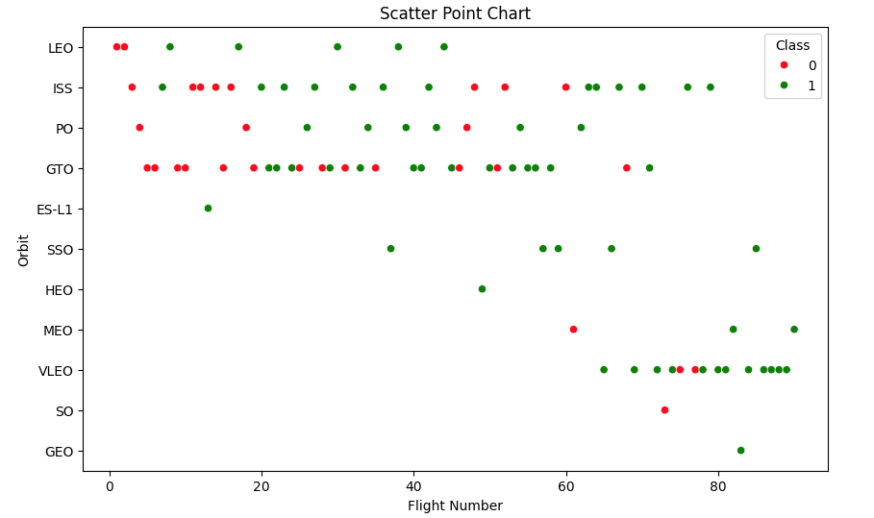
Flight Number vs. Orbit Type
In the scatter plot depicting Orbit Type vs. Flight Number, several insightful observations emerge, including:
The 100% success rates of GEO, HEO, and ES-L1 orbits can be attributed to each having only one flight into the respective orbits.
The remarkable 100% success rate in SSO is noteworthy, especially with five successful flights.
For GTO, there appears to be little correlation between Flight Number and Success Rate.
Generally, there is an observable trend where, as Flight Number increases, the success rate also increases. This trend is most pronounced for LEO, where unsuccessful landings are predominantly associated with lower flight numbers (early launches).

Slide 23
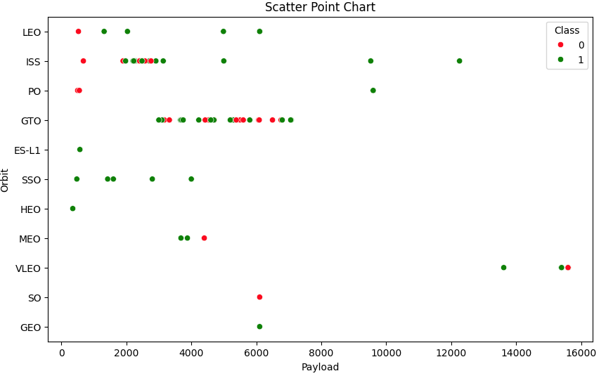
Payload vs. Orbit Type
The scatter plot illustrating Orbit Type vs. Payload Mass reveals insightful patterns:
Orbit types that exhibit greater success with heavy payloads include:
PO (although the data points are limited)
ISS
LEO
The relationship between payload mass and success rate for GTO is indistinct.
VLEO (Very Low Earth Orbit) launches are consistently associated with heavier payloads, aligning with intuitive expectations.

Slide 24
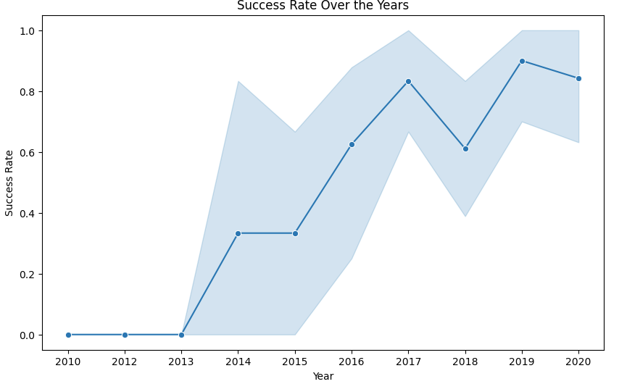
Launch Success Yearly Trend
The line chart depicting yearly average success rates provides the following insights:
In the period from 2010 to 2013, all landings registered as unsuccessful, yielding a success rate of 0%.
Post-2013, there is a general upward trend in success rates, despite minor declines in 2018 and 2020.
From 2016 onward, the success rate consistently surpassed 50%, indicating a sustained improvement in overall mission success likelihood.

Slide 25
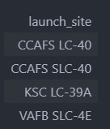
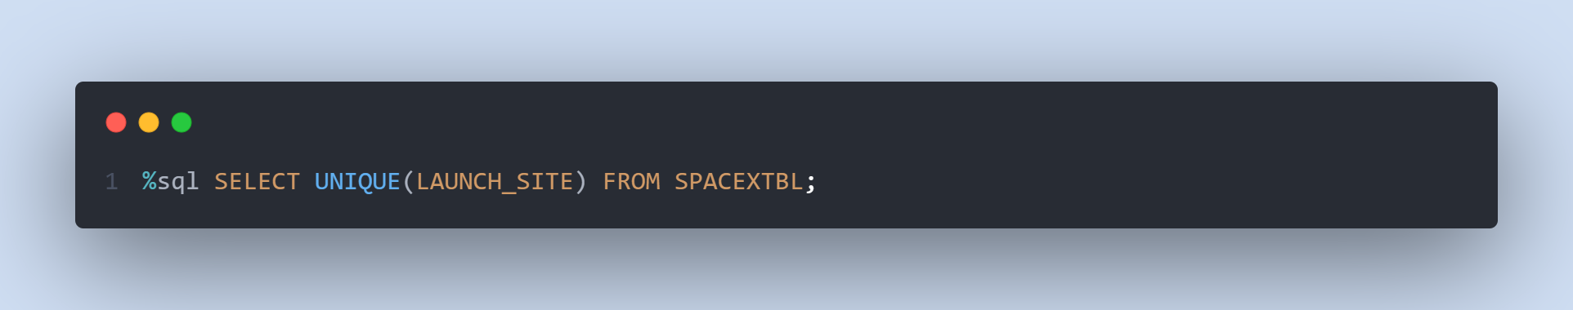
All Launch Site Names
Find the names of the unique launch sites
The word UNIQUE returns only unique values from the LAUNCH_SITE column of the SPACEXTBL table which are 4.

Slide 26
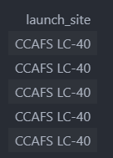
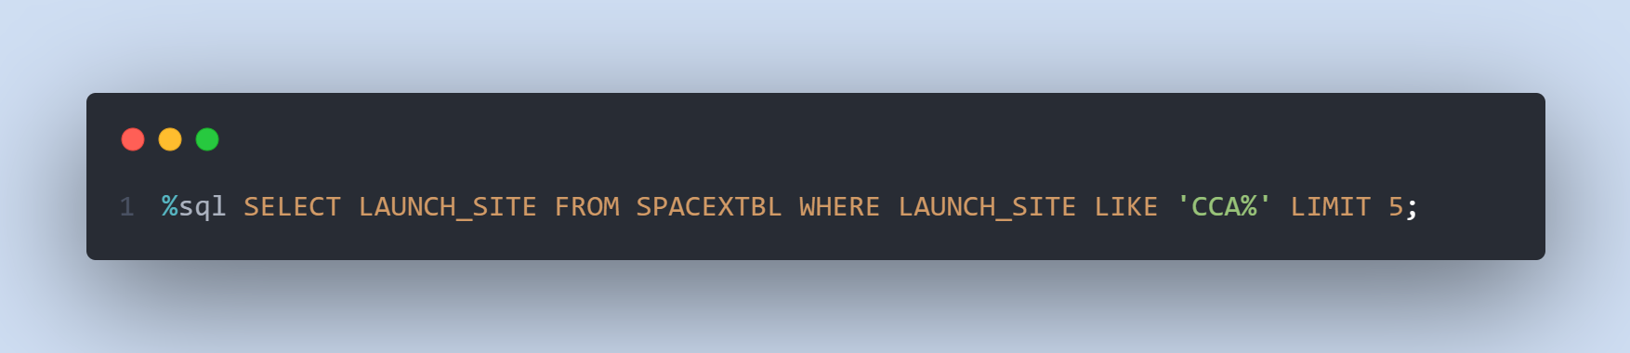
Launch Site Names Begin with 'CCA'
Find 5 records where launch sites begin with `CCA`
LIMIT 5 fetches only 5 records, and the LIKE keyword is used with the wild card ‘CCA%’ to retrieve string values beginning with ‘CCA’.

Slide 27
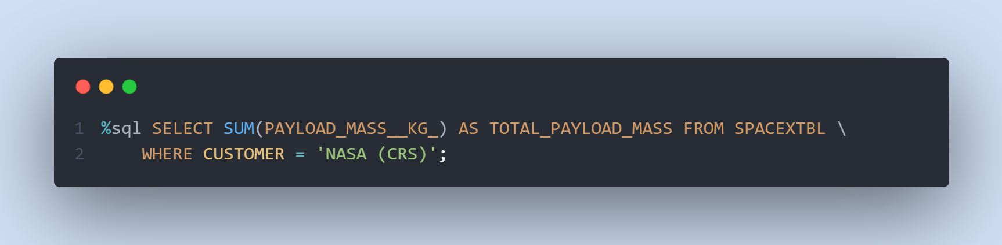
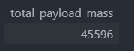
Total Payload Mass
Calculate the total payload carried by boosters from NASA
The SUM keyword is used to calculate the total of the LAUNCH column, and the WHERE keyword (and the associated condition) filters the results to only boosters from NASA (CRS).

Slide 28
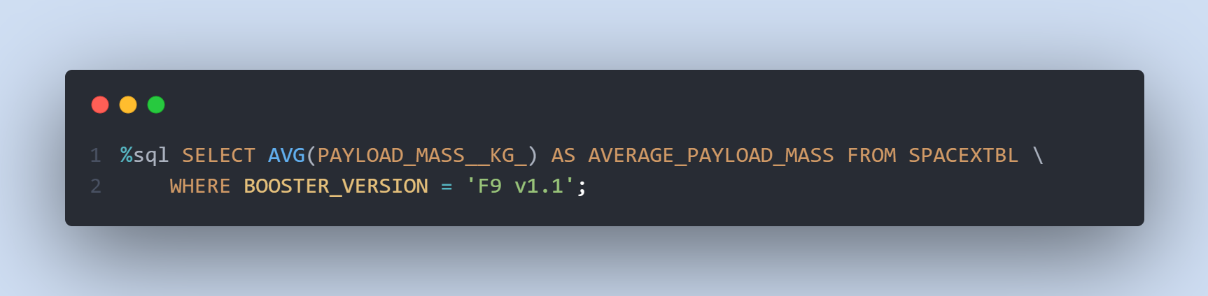
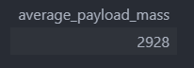
Average Payload Mass by F9 v1.1
Calculate the average payload mass carried by booster version F9 v1.1
The AVG keyword is used to calculate the average of the PAYLOAD_MASS__KG_ column, and the WHERE keyword (and the associated condition) filters the results to only the F9 v1.1 booster version.

Slide 29
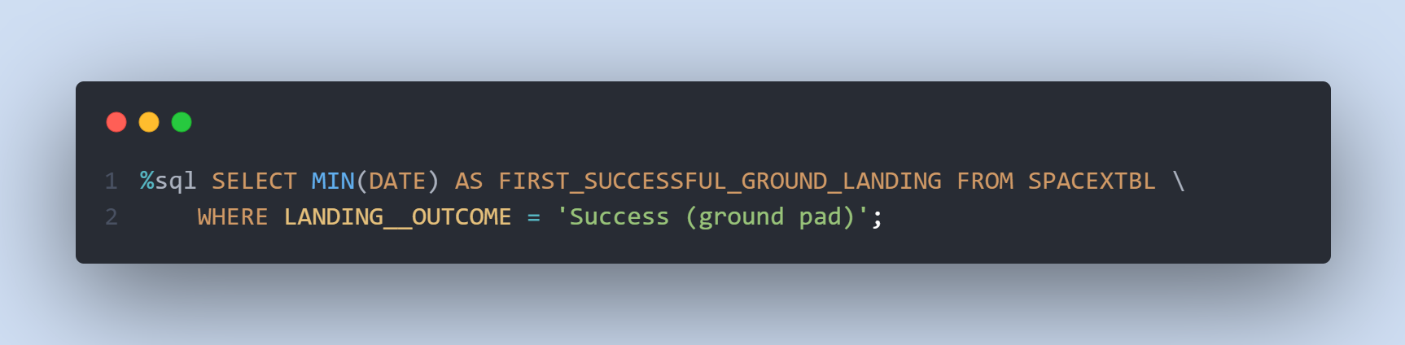
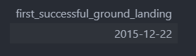
First Successful Ground Landing Date
Find the dates of the first successful landing outcome on ground pad
The MIN keyword is used to calculate the minimum of the DATE column, i.e. the first date, and the WHERE keyword (and the associated condition) filters the results to only the successful ground pad landings.

Slide 30
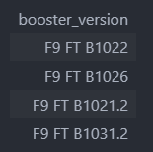
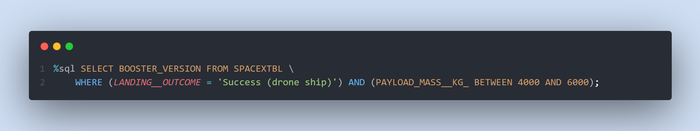
Successful Drone Ship Landing with Payload between 4000 and 6000
List the names of boosters which have successfully landed on drone ship and had payload mass greater than 4000 but less than 6000
The WHERE keyword is used to filter the results to include only those that satisfy both conditions in the brackets (as the AND keyword is also used). The BETWEEN keyword allows for 4000 < x < 6000 values to be selected.

Slide 31
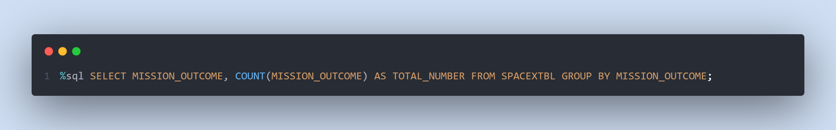
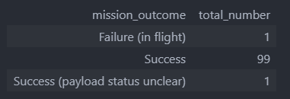
Total Number of Successful and Failure Mission Outcomes
Calculate the total number of successful and failure mission outcomes
The COUNT keyword is used to calculate the total number of mission outcomes, and the GROUPBY keyword is also used to group these results by the type of mission outcome.

Slide 32
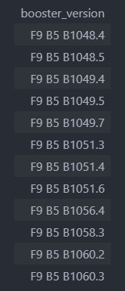
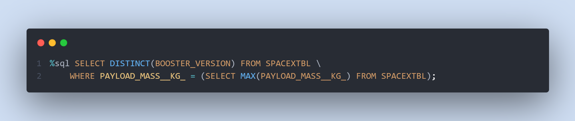
Boosters Carried Maximum Payload
List the names of the booster which have carried the maximum payload mass
A subquery is used here. The SELECT statement within the brackets finds the maximum payload, and this value is used in the WHERE condition. The DISTINCT keyword is then used to retrieve only distinct /unique booster versions.

Slide 33
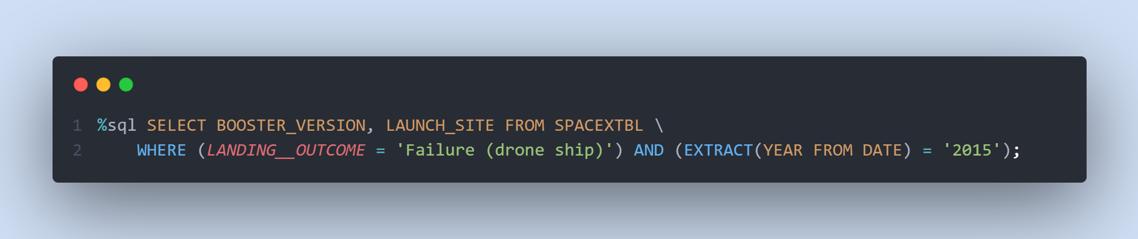
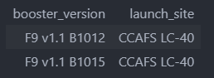
2015 Launch Records
List the failed landing outcomes in drone ship, their booster versions, and launch site names for in year 2015
The WHERE keyword is used to filter the results for only failed landing outcomes, AND only for the year of 2015.

Slide 34
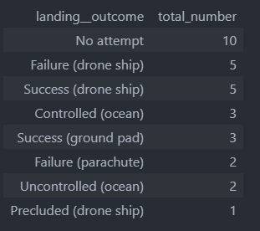
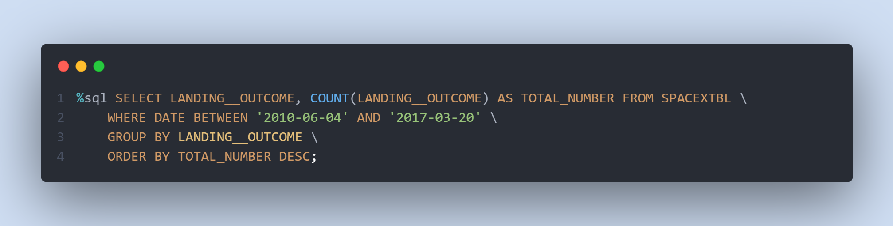
Rank Landing Outcomes Between 2010-06-04 and 2017-03-20
Rank the count of landing outcomes (such as Failure (drone ship) or Success (ground pad)) between the date 2010-06-04 and 2017-03-20, in descending order
The WHERE keyword is used with the BETWEEN keyword to filter the results to dates only within those specified. The results are then grouped and ordered, using the keywords GROUP BY and ORDER BY, respectively, where DESC is used to specify the descending order.

Slide 35

Section 3

Slide 36
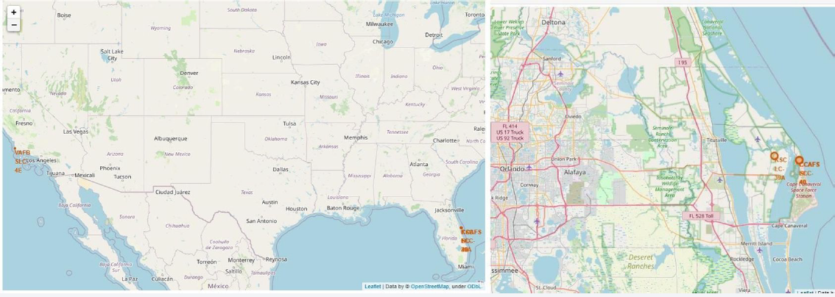
ALL LAUNCH SITES ON A MAP
The left map shows all launch sites relative US map. The right map shows the two Florida launch sites since they are very close to each other. All launch sites are near the ocean.

Slide 37




SUCCESS/FAILED LAUNCHES FOR EACH SITE
Launches have been grouped into clusters, and annotated with green icons for successful launches, and red icons for failed launches.
KSC LC-39A
CCAFS SLC-40 and CCAFS LC-40
VAFB SLC-4E

Slide 38
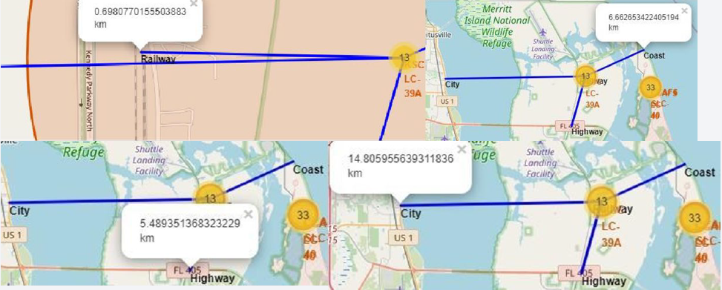
PROXIMITY OF LAUNCH SITES TO OTHER POINTS OF INTEREST
Using KSC LC-39A as an example, launch sites are very close to railways
for large part and supply transportation. Launch sites are close to
highways for human and supply transport. Launch sites are also close to
coasts and relatively far from cities so that launch failures can land in the
sea to avoid rockets falling on densely populated areas.

Slide 39

Section 4

Slide 40

launch success count for all sites
The launch site KSC LC-39 A had the most successful launches, with 41.7% of the total successful launches.

Slide 41

Pie chart for the launch site with highest launch success ratio
The launch site KSC LC-39 A also had the highest rate of successful launches, with a 76.9% success rate.

Slide 42

Launch Outcome VS. Payload scatter plot for all sites
Plotting the launch outcome vs. payload for all sites shows a gap around 4000 kg, so it makes sense to split the data into 2 ranges:
0 – 4000 kg (low payloads)
4000 – 10000 kg (massive payloads)
it can be shown that the success for massive payloads is lower than that for low payloads.

Slide 43

Section 5

Slide 44
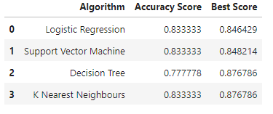
Classification Accuracy
All models had virtually the same
accuracy on the test set at 83.33%
accuracy. It should be noted that test
size is small at only sample size of 18.
• This can cause large variance in
accuracy results, such as those in
Decision Tree Classifier model in
repeated runs.
• We likely need more data to determine
the best model.

Slide 45
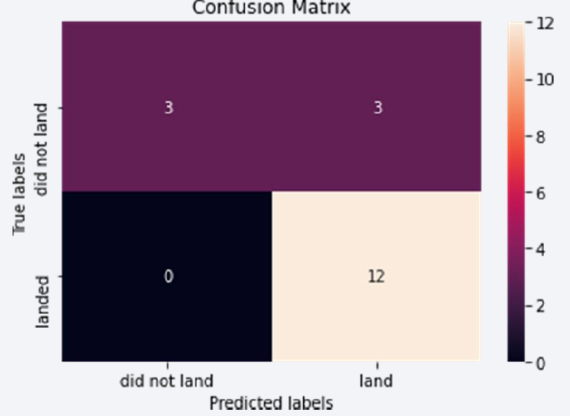
Confusion Matrix
• Since all models performed the same
for the test set, the confusion matrix is
the same across all models. The
models predicted 12 successful
landings when the true label was
successful landing.
• The models predicted 3 unsuccessful
landings when the true label was
unsuccessful landing.
• The models predicted 3 successful
landings when the true label was
unsuccessful landings (false positives).
Our models over predict successful
landings.

Slide 46
Conclusions
• ◦Our task: to develop a machine learning model for Space Y who wants to bid against SpaceX
• ◦The goal of model is to predict when Stage 1 will successfully land to save ~$100 million USD
• ◦Used data from a public SpaceX API and web scraping SpaceX Wikipedia page
• ◦Created data labels and stored data into a DB2 SQL database
• ◦Created a dashboard for visualization
• ◦We created a machine learning model with an accuracy of 83%
• ◦Allon Mask of SpaceY can use this model to predict with relatively high accuracy whether a
launch will have a successful Stage 1 landing before launch to determine whether the launch
should be made or not
• ◦If possible more data should be collected to better determine the best machine learning model
and improve accuracy

Slide 47
Appendix
Github repository:
https://github.com/boujyass/DS_IBM_Final_Project/

Slide 48


